Slide 1
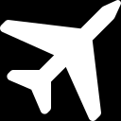
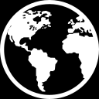
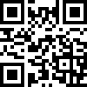
SPOKANE AIRLINES
Boarding Pass
Boarding Pass
SPOKANE AIRLINES
SECURE CLASS
PASSENGER: | TEAM 1
TRIP: | SPOKANE → CTF CITY
PLACES OF INTEREST: | WEB HACKING, CRYPTOGRAPHY, FORENSICS
PLACE TO STAY: | COMFY AIRBNB
DEPARTURE | FLIGHT
10 FEBRUARY | 00110101
9.00
Gate closes
30min
before departure.
Good luck!
DEPARTURE | RETURN | PRIVATE GUIDE
10 FEBRUARY | DECIDE YOURSELF | YOU KNOW WHO
9.00

Slide 2
SPOKANE AIRLINES
we value your security!

